Slide 1
HOW TO BE A KILLJOY
THE DARK TRIAD

Slide 2

TOPICS
A discussion of the nature and character of the Dark Triad
What is the Dark Triad? What does it consist of?
What does it tell us about human psychology and behavior?
How is it measured?
Does it have a common core? Are all of its elements necessary?
...

Slide 3


EVIL TRAITS
How many? Which ones?
Malice; Deceitfulness; Cruelty; Vindictiveness; Manipulativeness; Arrogance; Sadism; Greed; Selfishness; Ruthlessness; Intolerance; Jealousy; Corruption; Hatred; Narcissism; Envy; Spitefulness; Callousness; Hostility; Dishonesty; Malcontent; Vengefulness; Insensitivity; Contempt; Oppressiveness; Mercilessness
This is a big “tent” of traits.
Why interested in these traits?
What are some ways of studying them?
The Dark Triad

Slide 4
THE DARK TRIAD
An attempt to systematize a class of socially aversive psychological traits
Think of the Dark Triad as a tool - a diagnostic and predictive tool
Assumption(s): it is useful to do group them together; it is permissible to group them together = they have a common core

Slide 5
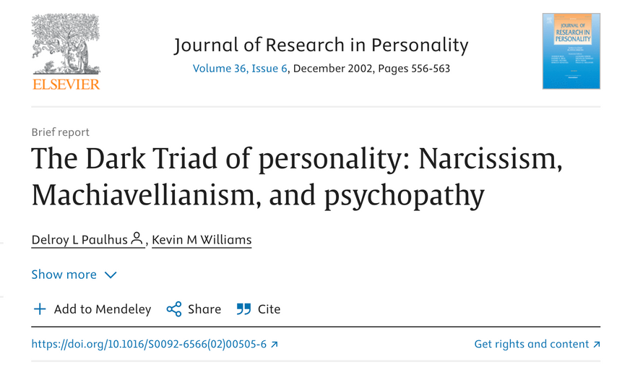
THE DARK TRIAD - ORIGINAL PAPER
Original paper by Paulhus and Willams (2002)
Focus on three personality traits that have received sustained attention: Machiavellianism, Narcissism, and Psychopathy
Main result by authors: these constructs were moderately correlated with each other but not equivalent (and thus distinct)

Slide 6


MACHIAVELLIANISM
A psychological construct that was postulated by Richard Christie
Based on statements found in Machiavelli’s works.
These statements, and as a result the construct itself, are supposed to capture a type of manipulative personality: this is the type of person who is often amoral, cynical, manipulative, and aims to achieve their own ends. Subsequent work added that individuals characterized by Machiavellianism also engage in planning, care about their reputations, and form coalitions.
Initial work by Christie and colleagues found that people who agree with those statements behave manipulatively both in experimental situations and in the real world.

Slide 7
MACHIAVELLIANISM
How is this construct measured?
MACH - IV is the most popular instrument.

Slide 8
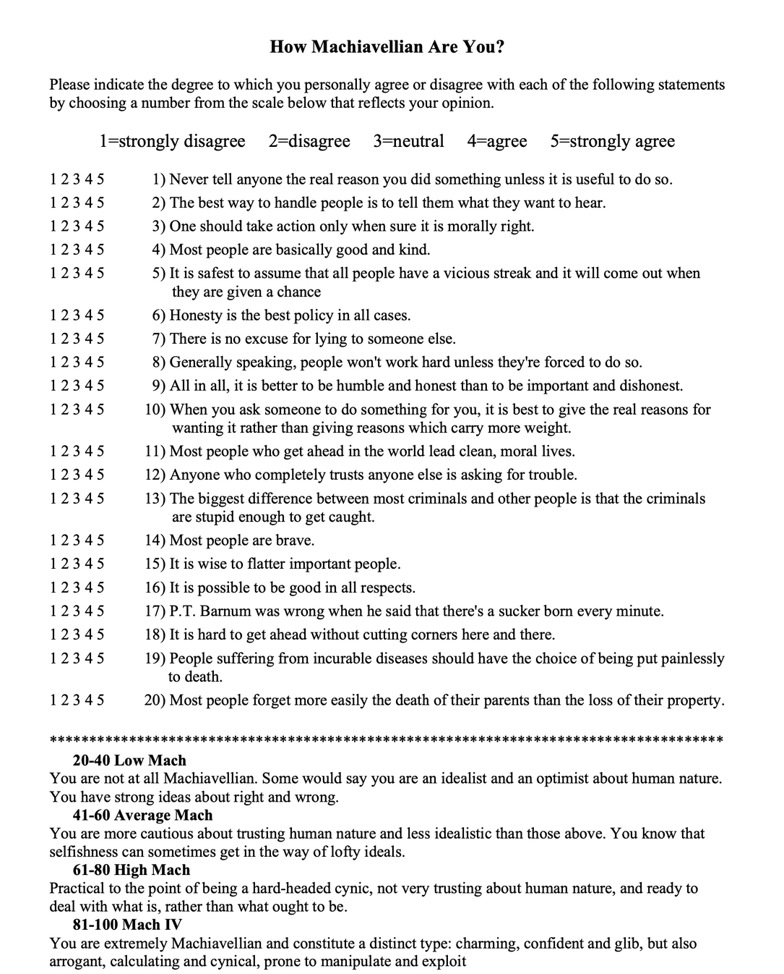

Slide 9

NARCISSISM
A psychological trait described by a sense of grandiosity, egoism, and self-orientation
There is both a clinical and sub-clinical version of this trait.
The Dark Triad focuses on the sub-clinical version
A key aspect of sub-clinical (or normal) narcissism is the presence of grandiosity. Other elements which are present include a sense of entitlement, and desire for dominance and superiority.
Grandiosity leads individuals to a quest of ego-reinforcement (which could lead to self-destructive behaviors). The cognitive processes characterizing narcissists tend to be self-deceptive (they believe their own boasts even if they are false). Grandiosity also promotes a sense of entitlement and even aggression (if grandiosity is threatened)

Slide 10
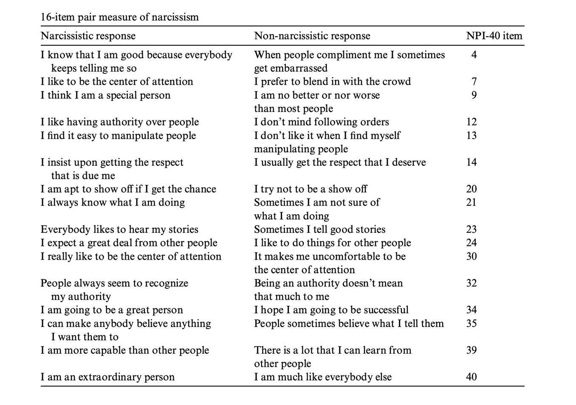
MEASURING NARCISSISM?
Two common tests: NPI (40 items) and NPI-16 (16 items)
https://psytests.org/darktriad/npi40en.html

Slide 11
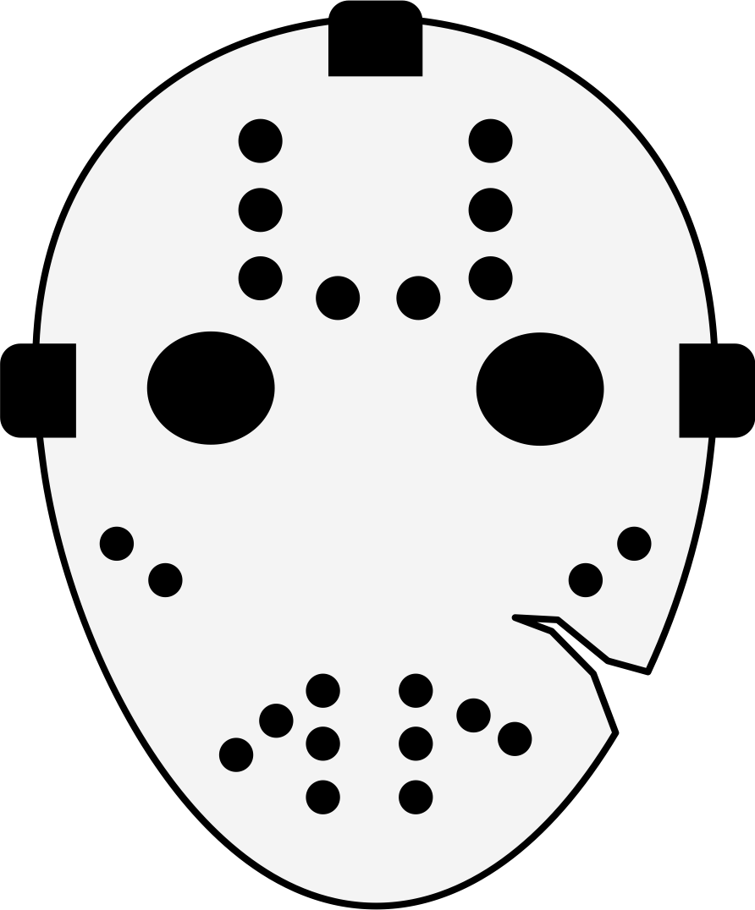
PSYCHOPATHY
A psychological trait described by impulsivity, antisocial behavior, and a lack of empathy and remorse
Again, there is both a clinical (=criminal) and sub-clinical version of this trait.
The Dark Triad focuses on the sub-clinical version
Psychopathy involves both deficits in affect (i.e., callousness) and self-control (i.e., impulsivity).
The self-control deficit is central to both criminal and noncriminal conceptions of psychopathy. What this means is that psychopaths manifest their callousness in a short-term fashion.
For example, they lie for immediate rewards, even if those lies compromise their long-term interests. Callous manipulation combines with other short-term traits (i.e., recklessness, and thrill seeking) to engender bold and relentless criminal behavior.

Slide 12
PSYCHOPATHY
How is it measured?
Most popular instrument is the Self-Report Psychopathy (SRP-III). It includes 64 items.
The SRP-III has four factors: antisocial behavior, impulsive thrill-seeking, cold affect, interpersonal manipulation
These are meant to be thought of as the four main characteristics of noncriminal psychopathy

Slide 13
THE DARK TRIAD - BACK TO ORIGINAL PAPER
Main result by authors: these constructs were moderately correlated with each other but not equivalent (and thus distinct)
Primary insight and motivation: “Despite their diverse origins, the personalities composing this Dark Triad share a number of features. To varying degrees, all three entail a socially malevolent character with behavior tendencies toward self-promotion, emotional coldness, duplicity, and aggressiveness.”
They thus seem to share something in common.

Slide 14
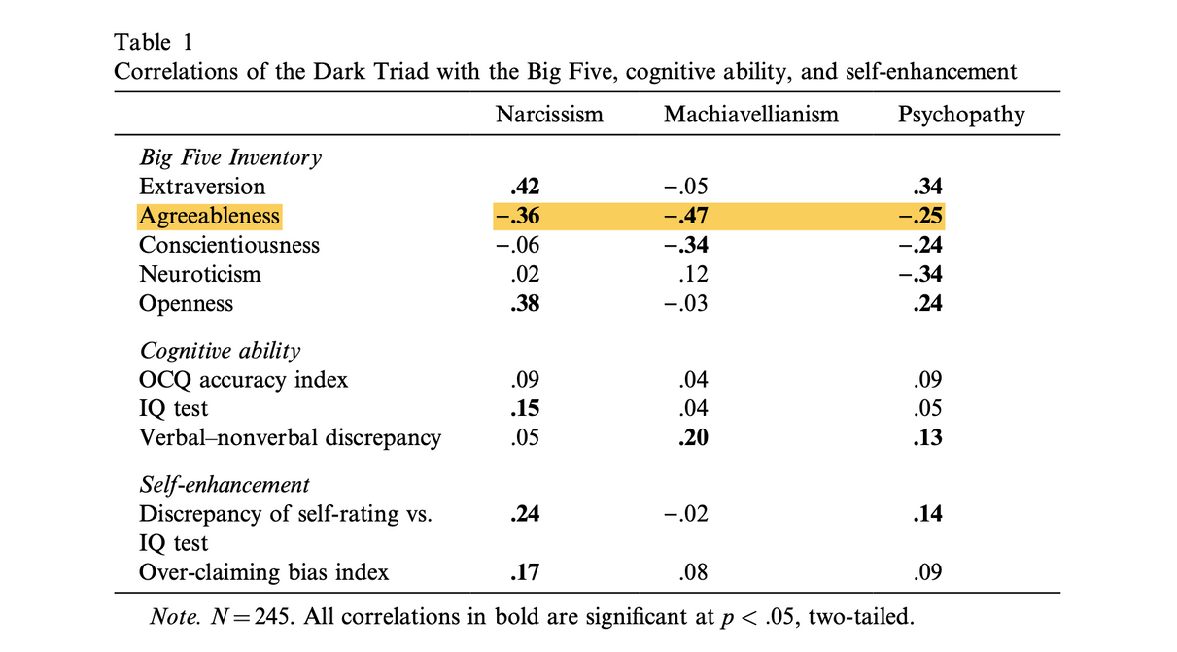
THE DARK TRIAD - BACK TO ORIGINAL PAPER
They all seem to be negatively correlated with agreeableness.
Agreeableness: one of the five major dimensions of personality in the Big Five personality traits model, which is widely used in psychology.
This trait reflects an individual's tendency to be compassionate, cooperative, and friendly towards others.

Slide 15
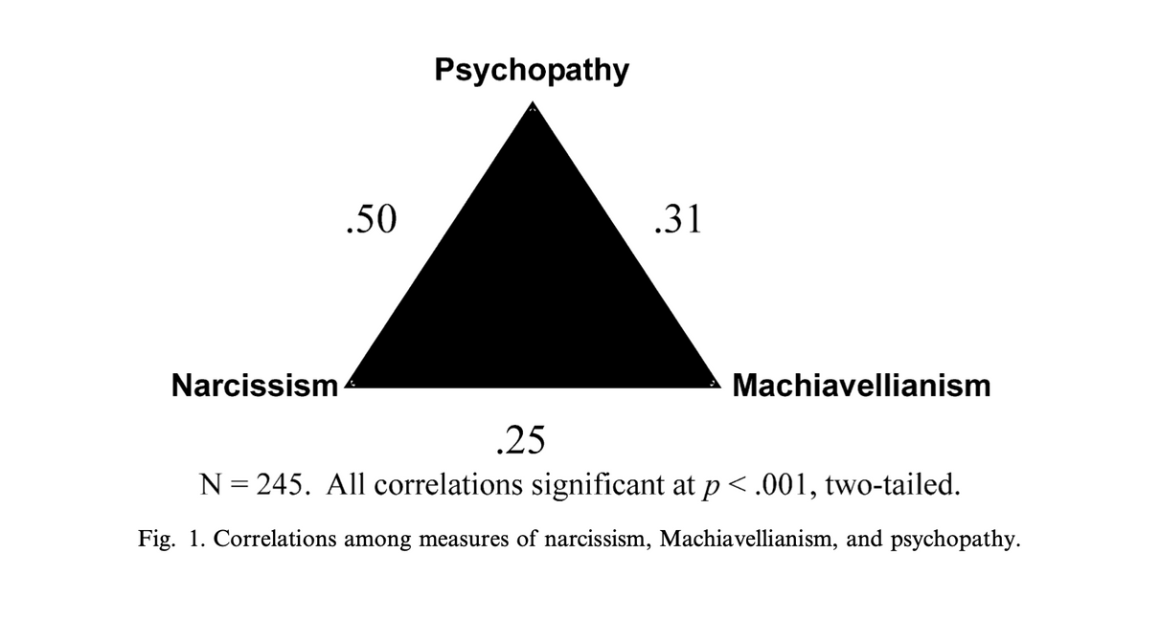
THE DARK TRIAD - BACK TO ORIGINAL PAPER
Yet the three are not one and the same...
They are correlated with each other but not to such an extent that one would conclude that they are identical constructs.
Differentially related to the Big Five

Slide 16
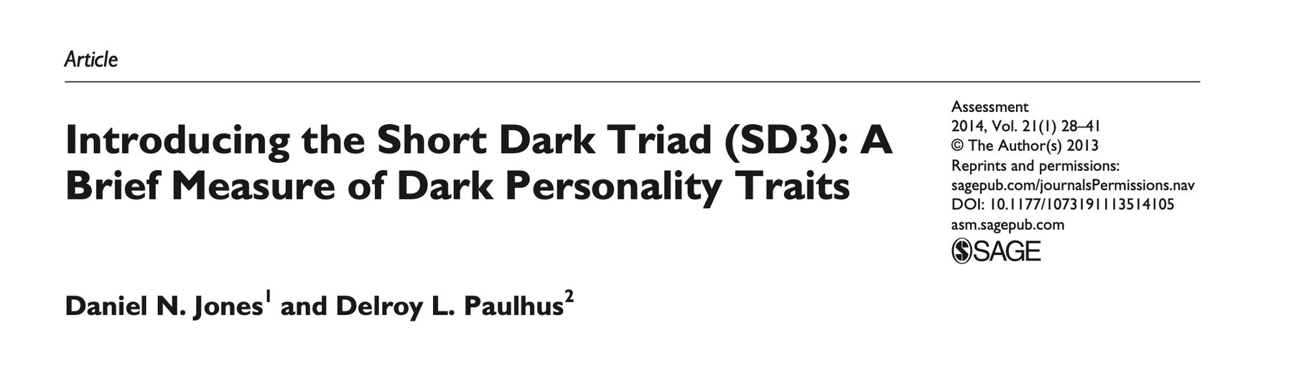
THE DARK TRIAD - A NEWER MEASURE
This is meant to be shorter measure of the Dark Triad—one measure for the three constructs instead of three long questionnaires.
The Short Dark Triad (SD3) was originally developed as an improvement over the Dirty Dozen (12-item questionnaire)

Slide 17

THE DARK TRIAD - A NEWER MEASURE
Aim was to single out (or focus on) key elements of each construct.
Machiavellianism: (a) manipulativeness, (b) callous affect, and (c) a strategic-calculating orientation.
Psychopathy: Impulsivity
Narcissism: Gradiosity
all three constructs “share a common callousness that encourages interpersonal manipulation”

Slide 18

THE DARK TRIAD - A NEWER MEASURE
Still, “the three traits exhibit unique behavior: Ego-promoting outcomes will be best predicted by narcissism, those involving reckless anti-social behavior will be best predicted by psychopathy, and outcomes predicted by a strategic orientation will be best predicted by Machiavellianism.”

Slide 19
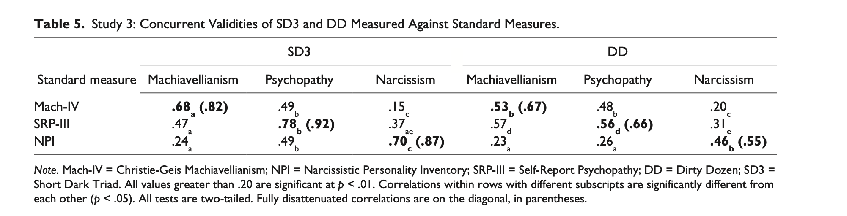
VALIDATION OF THE SHORT DARK TRIAD

Slide 20
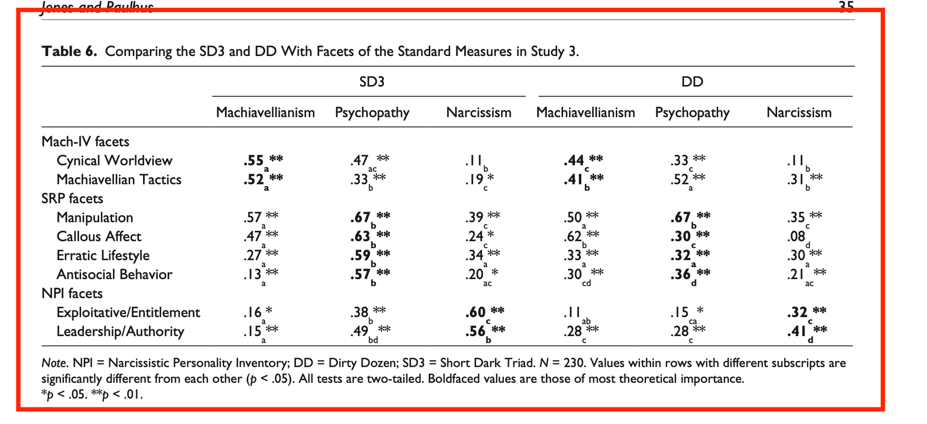
VALIDATION OF THE SHORT DARK TRIAD

Slide 21

THE DARK TRIAD - A NEWER MEASURE
Using a variety of approaches, we showed that the SD3 subscales provide useful proxies for the established Dark Triad measures they were meant to replace. We confirmed that the three subscales fell in the theoretically appropriate circumplex locations and provided full coverage of the classic constructs. Gender differences paralleled those of the longer measures. Of particular importance, we demon- strated external validity by showing that the SD3 scales predicted corresponding informant-ratings. Hence, the Dark Triad constructs are not just artifacts of self-report variance.
CONCLUSION

Slide 22
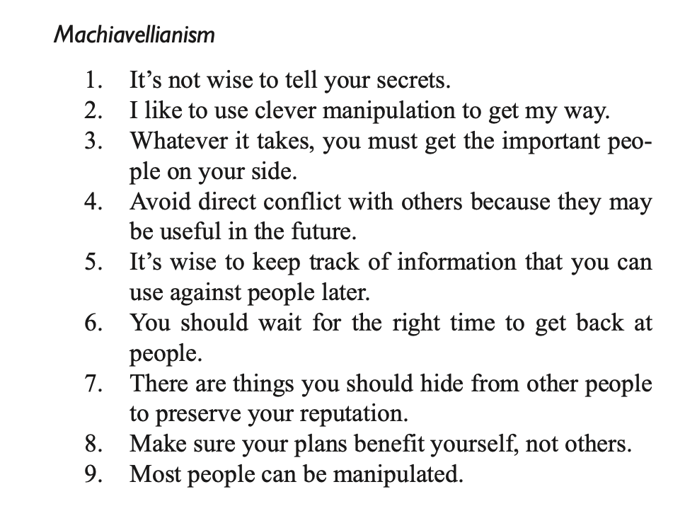

Slide 23
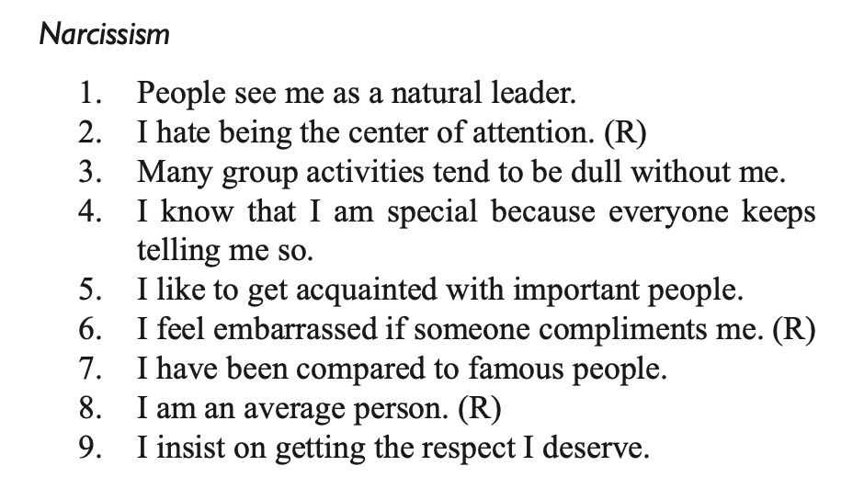

Slide 24
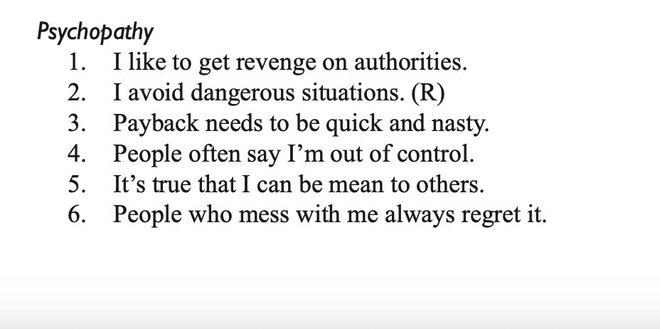
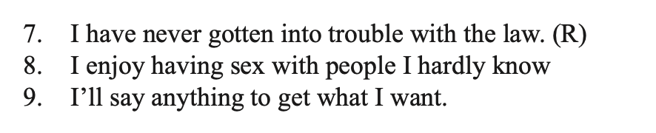

Slide 25
SOME RESULTS FROM THE SHORT DARK TRIAD
RESULTS

Slide 26

THE DARK TRIAD - KEY ISSUES
These are measures of subclinical (“normal”) personality traits .
“Clinical samples comprise individuals those currently under clinical or forensic supervision; Subclinical samples refer to continuous distributions in broader community samples” (Furnham et al., 2013, p. 200)
Both psychopathy and narcissism have their origins in clinical psychology and psychiatry. Machiavellianism does not.

Slide 27

THE DARK TRIAD - KEY ISSUES
How much overlap is there between the three constructs?
The three are correlated with each other (Expected?) and they show similar correlates
“The key to differentiating the Dark Triad lies in administering measures of all three to the same sample and applying multiple regression to determine their independent contributions.” (Furnham et al. , 2013, p. 203)
“When regression analyses are conducted, differences among the Dark Triad outcomes become clear. Here are some examples. Compared to the other two, Machiavellians are more likely to plagiarize essays... and avoid risky bets... More than the other two, narcissists self-enhance...and aggress after ego threat.... Finally, more than the other two, psychopaths bully others ..., and carry out their revenge fantasies.... “ (ibid.)

Slide 28

THE DARK TRIAD - KEY ISSUES
How do they relate to known and influential structural models of personality?
The Big Five Model and the Big Six (HEXACO model)

Slide 29
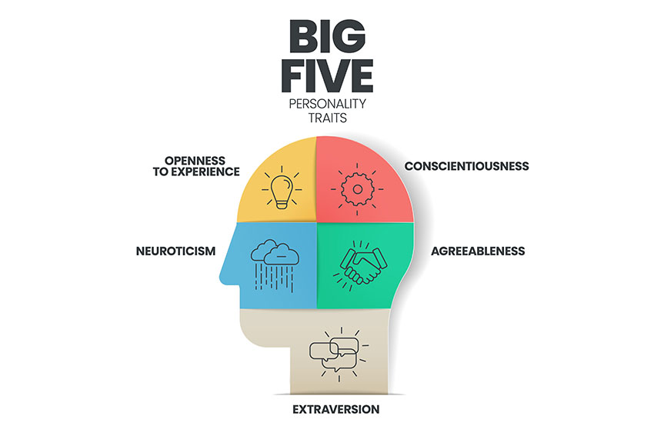
Big Five
Neuroticism: Anxiety, hostility, depression, self-consciousness, impulsiveness, vulnerability
Extroversion: Warmth, gregariousness, assertiveness, activity, excitement-seeking, positive emotions
Openness to experience: fantasy, aesthetics, feelings, actions, ideas, values
Agreeableness: Trust, straightforwardness, altruism, compliance, modesty, tender-mindedness
Conscientiousness: Competence, order, dutifulness, achievement striving, self-discipline, deliberation

Slide 30
Key results:
Negative associations with agreeableness and conscientiousness
“Distinctions among the Dark Triad emerge when the Big Five facets are separated. For narcissism, the strongest associations are with low Modesty and low Straightforwardness whereas psychopathy associations are strongest with low Deliberation and low Dutifulness .... Distinctions also emerge with the facets of Conscientiousness: the strongest correlates of narcissism are achievement-striving and competence whereas the strongest correlates of psychopathy are low dutifulness and low deliberation....” (Furnham et al., 2013, p. 204)

Slide 31
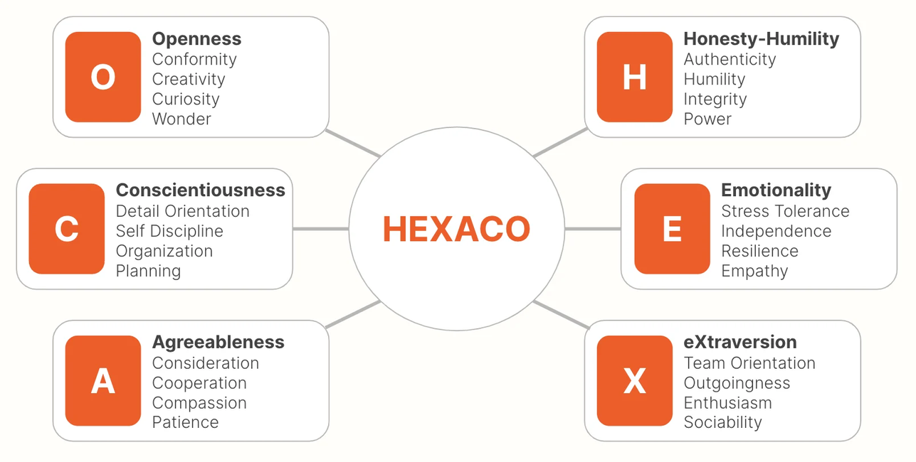
Big Six (HEXACO) Model
The relevance of Honesty-Humility
“Because it explicitly contrasts pro-social and anti-social behavior, this factor is more relevant to the Dark Triad than are any of the Big Five dimensions. Empirical results have been rather straightforward: All three of the triad load on that sixth factor” (Furnham et al., 2013, p. 204)

Slide 32
From Koehn et al. 2019, p. 8
However, while the traits are bound together as a constellation, they have their own unique links as well. For example, recent work (Muris, Merckel- bach, Otgaar, & Meijer, 2017) suggested that narcissism was positively associated with extraversion, conscientiousness, and openness; Machiavellianism was negatively associated with extraversion; and psychopathy was negatively associated with conscientiousness. While the traits show strong associations with low honesty–humility, facet-level analysis revealed an overall lack of sincerity, Machiavellianism and psychopathy were related to a lack of fairness, and narcissism was associated with deficits in modesty and greed avoidance.

Slide 33

THE DARK TRIAD - KEY ISSUES
“If the Dark Triad members are not interchangeable, then why are they always positively correlated – regardless of the instrument used to measure them?”
One answer: they share a common core.
What is that though? Different suggestions in the literature:
Agreeableness
Interpersonal antagonism
Social exploitativeness
Callousness (low empathy)

Slide 34

THE DARK TRIAD - KEY ISSUES
What are the origins of the triad?
Research suggests that there could be a genetic component...but Machiavellianism appears to be the trait that is most likely to be affected by experience (and thus environment and upbringing)
Evolutionary psychologists have suggested that these trait may have conferred an evolutionary advantage.
Difficult claim to be evaluated...but needs to be taken seriously.

Slide 35

THE DARK TRIAD - KEY ISSUES
What are some of the major outcomes of the Triad?
Workplace:
Dark traits may help get ahead but not to get along with others.
“Successful” psychopaths and narcissists do not enjoy long-term success.
Machiavellians use a variety of tactics; psychopaths hard tactics; and narcissists soft tactics. (Soft= subtle and less confrontational; hard = direct and confrontational)
Classroom cheating vs. plagiarism: psychopaths cheat in classroom; Machiavelians are more likely to plagiarize.
Mating and Dating:
Males receive higher scores
Differences between the three traits: psychopaths tend to be manipulative as partners and are both aggressive and impulsive.

Slide 36
THE DARK TRIAD - KEY ISSUES
What are some of the major outcomes of the Triad? (Continued)
Antisocial behavior:
Psychopaths are bullies, aggressive, and carry out their deviant fantasies.
Narcissists only find recourse to violence when there is significant ego-threat
Machiavellians are more careful and more calculative. However, they can act like psychopaths under certain conditions.
Differences between the three traits: psychopaths tend to be manipulative as partners and are both aggressive and impulsive.
Interpersonal relationships:
All three score high on ruthless self-advancement
They are associated with prejudice
All three use humor (aggressive or affiliative [narcissists]) as interpersonal strategy
All three are related to sexual harassment

Slide 37
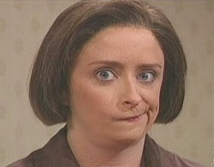

THE DARK TRIAD AND KILLJOYS
Round 1

Slide 38
THE DARK TRIAD AND KILLJOYS
Round 2

Slide 39
THE DARK TRIAD AND KILLJOYS
Round 3

